Slide 1
Best Practices for Submitting Your Expense Reports
Chris Agro, BA, CRA
Administrative Director
Gordon Center for Medical Imaging

Slide 2
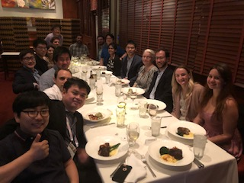
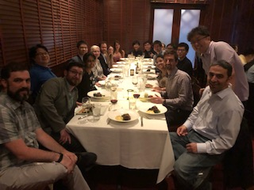
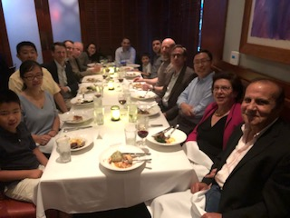
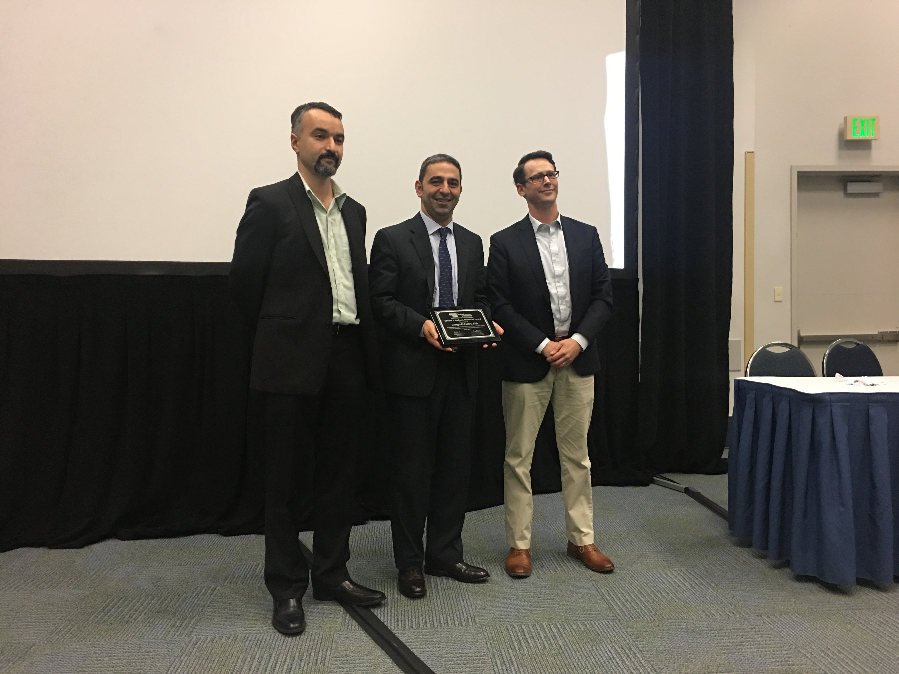
Welcome back from SNMMI Annual Meeting

Slide 3
Today’s Objectives
Provide you with insight into some of the most common reasons why expense reports get returned for revision and ways to avoid this so that you can get reimbursed as quickly as possible
Provide you with an understanding of the correct process to submit an expense report based upon your HR status.
Notes:
This session isn’t designed to be a step by step explanation of the Expenses module of PeopleSoft. We don’t have time for that.

Slide 4
Preparing to submit your Expense Report
All postdocs, graduate students, weekly-paid employees and Instructors without their own grants should first ask the PI/ supervisor/mentor to which fund# your expenses should be charged.
If your PI just gives you the name/title of the grant, please check with the administrator managing the grant (Chris, Ramzi, Leigh, or Katia).
Gather all receipts and other required documentation (prior approvals, etc.)

Slide 5
Step One
There are two basic criteria to keep in mind when deciding whether to request reimbursement for an expense:
is it allowable according to the Partners business expense policy?
Is it allowable according to the funding sponsor’s (NIH, DoD, industry contract, etc.) policies?

Slide 6
Keep in Mind: NIH Cost Principles
There are 4 guiding principles to determine whether a cost can be
charged to an NIH grant award. Is the cost:
Reasonable? Is the cost necessary for the grant’s performance? Does the cost reflect what a “prudent person” would pay?
Allocable? Will the cost incurred have a demonstrable and specific benefit to the project to which it is charged?
Allowable? The cost must not be designated as “unallowable” under Section J of OMB Circular A-21 and/or adhere to the terms and conditions of the particular award.
Treated Consistently? Is the cost treated in the same manner, as either direct or indirect, when used in like circumstances at the institution?
NIH Grants Policy Statement, Section 7: https://grants.nih.gov/grants/policy/nihgps/nihgps.pdf

Slide 7
Top Reasons Expense Reports are Sent Back for Revision
Insufficient business purpose detail
Unallowable expenses, including unallowable airline for foreign travel
Expenses on days other than permitted travel days
Meals over the limit
Not enough detail about attendees at a multi-person meal
Lack of detailed receipt or currency conversion documentation
Lack of prior approval documentation for purchases on personal credit card or exceptions to Partners business expense policy

Slide 8
Submitting an Expense Report is like…
Telling a whole story
How did you commute to the airport?
Where did you stay?
Meals you had – only 1 breakfast, lunch and dinner allowed per day!
Did you have beverage/snack in lieu of a meal ? (If yes, which meal did the snack replace?)
How did you commute from the conference/hotel site to the airport on the way back?
How did you arrive home?
The goal is to have everything documented in an understandable way not just for the approver looking at it now but also for a potential future auditor who may be looking at it years after you took the trip when it’s difficult to remember the details & nuances.
Notes:
If there’s anything unusual about your report (booked two one-way flights instead of a roundtrip because it was cheaper that way, stayed with family members instead of in a hotel, etc.) please explain it.

Slide 9
Submitting a Complete Report
Your expense report is intended to be a complete report of all expenses associated with your trip, not just a list of the expenses for which you are requesting reimbursement.
If your airfare was booked via Egencia and charged directly to an MGH fund number, it still needs to be included on your expense report but should be marked as pre-paid so that you don’t receive reimbursement for that cost.
If another organization is paying for part of your trip, the expenses they are paying for should be included on your expense report but should be marked as pre-paid.
Notes:
This may seem counter-intuitive but it is base don IRS guidelines for business expenses.

Slide 10
Submitting a Complete Report
If another MGH employee paid part of your expenses (i.e. you shared a hotel room and one person paid for both people), the cost of the shared expense needs to be listed on both people's expense reports and a comment should be added explaining that it was a shared expense that was paid for by ________.
On the report for the person who didn't pay, it should be marked as pre-paid.
Notes:
The preferred method in this situation would be for the bill to be split and for each employee/non-employee to pay for their own share. But sometimes that isn’t possible.

Slide 11
Submitting a Complete Report
Normally you cannot be reimbursed for travel expenses until you have completed the trip. In exceptional circumstances when you have already been reimbursed for the registration fee for the conference (or an abstract submission fee), this should still be included on the expense report for the conference trip and should be marked as pre-paid.
If you can’t fit the necessary explanation (shared expenses, unusual travel dates, etc.) into the appropriate field on the expense report, upload a pdf of the explanation with the receipts.

Slide 12
Business Purpose Detail
You need to explain:
1) why the expenses of the trip are allowable business expenses
2) why it is allowable on the grant to which it’s being charged (if being charged to a grant)
Why did you attend the conference?
What did you do?
How did it benefit the grant?
Professional development/staying current in the field is not an acceptable business purpose for travel on most NIH grants (exceptions are training grants (Ts and Fs) and career development grants (Ks)).
Keep the business purpose as simple as possible while giving enough detail to understand.
Notes:
If there are multiple purposes, only mention the one that benefits the grant. Otherwise you will be required to split the cost in proportion to the amount of benefit each funding source will receive from the trip.

Slide 13
Business Purpose Detail Examples
Close but not enough:
My expenses will be charged to fund number 231395.
Traveled to Anaheim to present our work on imaging oxidative stress and inflammation which are topics of the grant.
Acceptable:
Traveled to SNMMI annual meeting in Anaheim to present our work on imaging oxidative stress and inflammation, which was funded by the grant P41EB022544

Slide 14
Business Purpose Detail Examples
First try:
My expenses will be charged to fund number 123456.
Traveled to Anaheim to learn about new radiotracers for brain imaging which are topics of the grant.
Acceptable:
Traveled to SNMMI annual meeting in Anaheim to learn new technique for producing XXX, which is necessary to perform my role on the grant R01EB012345

Slide 15
Foreign Airlines
The NIH has complex rules about when/why you are allowed to charge air travel on foreign airlines to an NIH grant. DoD doesn’t allow you to charge air travel on a foreign airline to a DoD grant under any circumstances. Before booking a flight on a foreign airline, please consult the grant manager who manages the fund to which your trip will be charged to ensure you will can be reimbursed for that flight.
Notes:
For NIH purposes, travel between the US & Canada is considered domestic travel, not foreign travel and US flag carrier must be used.

Slide 16
Permitted Travel Days
According to Partners policy, an employee is expected to travel the day of, or if necessary, the day before the start of the conference, meeting, or other business event.
The employee must return on the last day of, or if necessary, the day following the conclusion of the event.

Slide 17
Permitted Travel Days
If travel expenses (including transportation, lodging, meals, etc.) are incurred on days other than these, they will be considered personal in nature and, although the air travel itself may be an allowable expense (if the airfare is the same as or less than if the employee had left or returned on the permitted travel days), other expenses incurred on those days are not payable or reimbursable unless they were due to extenuating circumstances acceptable to Partners (see the policy for details on acceptable exceptions).

Slide 18
Permitted Travel Days
If you travel on days other than the permitted travel days (added on a few days of vacation, etc.) you must explicitly attest that the non-standard travel dates did not increase the cost of the business trip. It is preferable that you upload contemporaneous documentation that the non-standard travel dates did not increase the cost of the business trip.
Example: a pdf of an unbooked itinerary showing the cost if you had traveled on the standard dates, in addition to the booked itinerary on standard dates with cost indicated.
Please note this documentation should be contemporaneous to the time you booked your flights, not to the time when you submit the report.

Slide 19
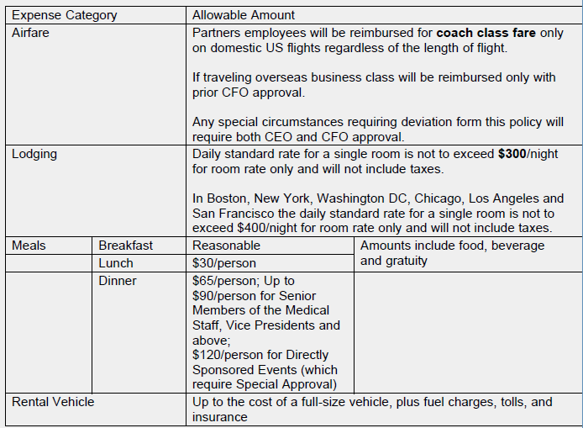
Allowable Amounts
Expenses for airfare, lodging, meals, and rental vehicles must fall within the limits specified for these items.
Notes:
Please note these are the maximum amounts allowed by Partners. The budget for the grant to which your trips is being charged may be more restrictive.

Slide 20
Allowable Amounts
Expenses for airfare, lodging, meals, and rental vehicles exceeding the limits will not be reimbursed unless you have requested and received prior approval from Joe Carone, the MGH Controller. A pdf of Joe’s approval email or the signed directly sponsored event form must be included with the expenses.
Alcohol cannot be charged to a federal grant fund.
Alcohol without a meal will not be reimbursed regardless of funding source.

Slide 21
Rental cars
Expenses for ground transportation to attend conferences or events are allowable but are limited to the "most economical means“ of transportation that provides a reasonable level of comfort and convenience.
“Most economical means” using public transportation, airport shuttle services, a personal auto with mileage and parking reimbursement, rental vehicle, local taxi service, or Uber/Lyft. Use of Partners shuttles is expected when possible.
Not Reimbursable:
Private coach or limousine services
Normal commuting expenses between home and place of work
Cost of repairs, fines for violations, parking tickets, or towing charges

Slide 22
Allowable vehicle rental costs
Daily rental fee for up to a full-size vehicle
Fuel charges
Tolls
insurance purchased in conjunction with the rental vehicle
Please note that if you use your personal vehicle for business purposes, you CANNOT be reimbursed for the above expenses. Instead, per IRS guidelines, you will be reimbursed at the published IRS rate per mile traveled. You should include a pdf of Google maps or other sufficient documentation of the mileage for your business trip.
You can be reimbursed for parking charges during a business trip regardless of whether you used a rental car or personal vehicle.

Slide 23
I paid for a group lunch.
Q: If you paid for the full cost of your lunch and that of two of your postdocs who are also MGH employees or non-employees who are attending the same conference, can you get reimbursed?
A: Yes, assuming that the allowable limits are met, an allowable business purpose for the meal is documented and any sponsor limits/regulations have been respected.
You must add the names & affiliations of all attendees of a meal, not just mention them in the line item description for the meal.

Slide 24
I paid for a group lunch, part 2.
Q: If you paid for the full cost of your lunch and that of a collaborator who attended the same conference, can you get reimbursed?
A: Yes, assuming that the allowable limits are met, an allowable business purpose for the meal is documented and any sponsor limits/regulations have been respected.
However, you need to document in the expense report what you discussed and why the meal was necessary for the grant, not just that the person is a collaborator on the grant to which the meal is being charged.
Ex: you’re meeting with a collaborator, Dr. X, in between/after conference sessions due to time constraints of conference to discuss current project on XX or knowledge sharing/relationship building for future potential projects, or possible recruitment, etc.

Slide 25
Receipts
For MGH/Partners business expense reimbursements, any submitted receipt must show:
method of payment (some portion of your credit card account number or the check # or that cash was used)
proof of payment- it should say it was paid, not just be an invoice.
If payment was by credit card or check, the receipt should have your name on it as the person who paid. If your receipt doesn't show this, you can use the receipt and a copy of your credit card statement (with non-pertinent info like your balance and partial account number blacked out for privacy) that shows the vendor name to meet the "proof of payment" requirement.
itemized list of what was purchased. The credit card top copy receipt that just lists the subtotal, tip and total is not sufficient, it must give an itemized description of what was purchased.
If the receipt is in a foreign currency you must include a pdf of the conversion of each line item using a website such as xe.com or a copy of your credit card statement showing the exact USD amount you paid for the expense charged in a foreign currency.

Slide 26
Lost Receipts
Employees who lose required receipts should seek a duplicate receipt if possible.
If a duplicate is unobtainable, the employee must check the “Lost Receipt” box in the expense report and provide an explanation and must submit other records or evidence (such as paid bills, or whatever other document(s) best substantiates or reflects the details of the paid expense) to corroborate the information about the expense provided in the Employee Business Expense Report or other required documentation.
Expenses that are not supported by required receipts or other records or evidence acceptable to Partners will not be paid or reimbursed.

Slide 27
Methods to submit expense reports

Slide 28
Non-Employees
If you are a non-employee (i.e. do not receive a paycheck from MGH), please complete the Excel non-employee business expense report form found on the intranet, sign it and return it to Sooyoung Han at shan14@mgh.harvard.edu with a pdf of your receipts and any explanations and prior approval documentation.
She will obtain the appropriate approval signature, submit the eCheck request via PeopleSoft and within 2-3 weeks a check will be mailed to you at the address you provided on the expense report.

Slide 29
Employees on MGH payroll
Complete your expense report in the Expenses module of PeopleSoft, and upload your scanned receipts & any other documentation to the report
Please be sure to enter the username of the appropriate approver. Otherwise it will default to the approver for your last report, which may not be correct in this case.

Slide 30
Self-Enrollment Request for Access: Expenses and eCheck
If you have never used the expenses or eCheck module of PeopleSoft before, you will need to self enroll before you will see these modules in your PeopleSoft menu.
Access to Expenses Employee Reimbursement system and the eCheck Online Check Request system is gained through a self-enrollment process in PeopleSoft Financials. Follow the steps below to sign up for access to either system:
Log in to PeopleSoft Financials (https://peoplesoftportal.partners.org/public/)
Enter your network User ID and Password.
Select Financials Production.
Click Main Menu -> PHS Self Enrollment.
Select either Expenses Self Enrollment or eCheck Self Enrollment.
Enter your User or Employee ID and follow the instructions.
Upon successful enrollment, you will receive an automated email with training and support information.
If you have any questions regarding self-enrollment, please contact Partners Supply Chain Client Services at (617) 726-2142 or email mmclientservices@partners.org.

Slide 31
Expenses Module
More information about the Expenses module of PeopleSoft can be found at http://supplychain.partners.org/training-and-application-support/how-to-use-expenses.aspx .
If you have never used the Expenses module of PeopleSoft before, you will need to self-enroll using the instructions above before you will be able to access it the first time.

Slide 32
Tips on submitting your Expense Report
Radiology Dept policy says that the expense report approver must be a department administrator with knowledge of the grants.
Chris Agro is the designated Dept. Administrator for the Gordon Center. Username: CAP43
The Gordon Center has a two-step approval process. Employees should list Dr. El Fakhri (username GE8) as the approver on their PeopleSoft expense report. Once he has reviewed it, he will add Chris as the final approver and route it to her.

Slide 33
Supply Chain Client Services
If anyone has questions about what is an allowable expense, limits for meal types, etc. please consult the Partners Employee Business Expense Policy here: https://grcarcher.partners.org/foundation/Workspace.aspx?workspaceId=-1&requestUrl= If you have questions not answered there, consult the grant administrator for your lab (Chris, Ramzi, Katia or Leigh)
If you have questions about the Expenses module of PeopleSoft or the status of your report after you’ve submitted it, please call Supply Chain Client Services at 617-726-2142.

