Slide 1
Controlled Substances Used in Non-Human Research
Kelé Piper, Director, Research Compliance
October 2021

Slide 2
Resources

Slide 3
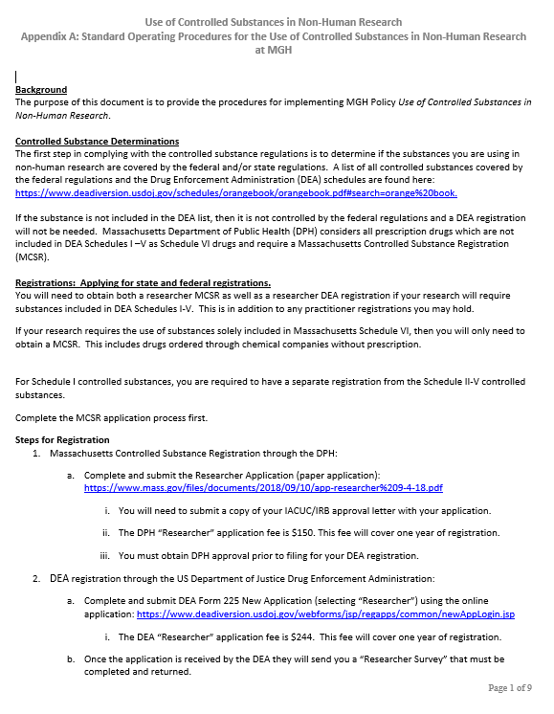
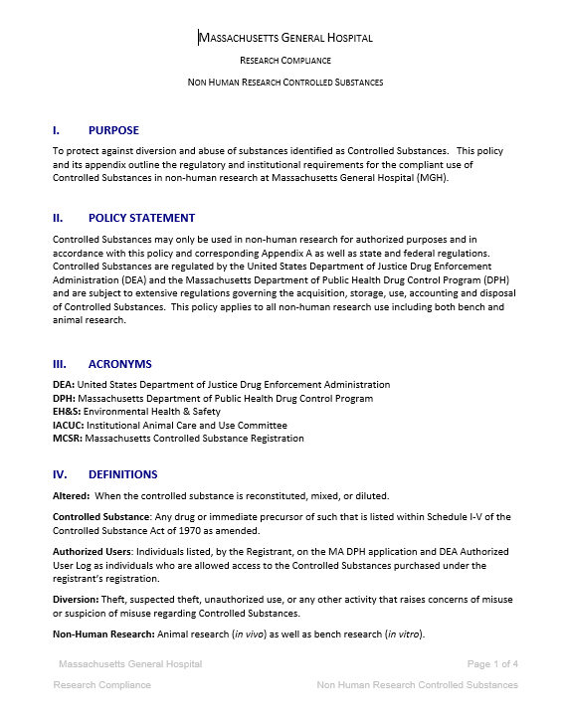
Policy and SOP

Slide 4
Research Compliance Webpage

Slide 5
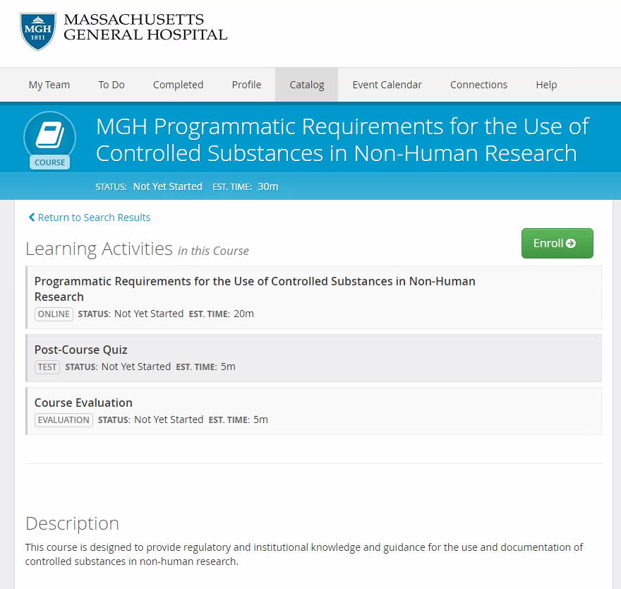
HealthStream Training

Slide 6
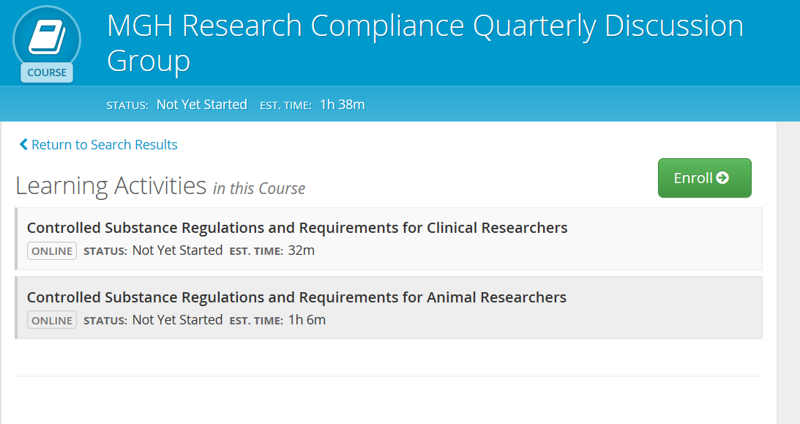
Quarterly Discussion Groups

Slide 7
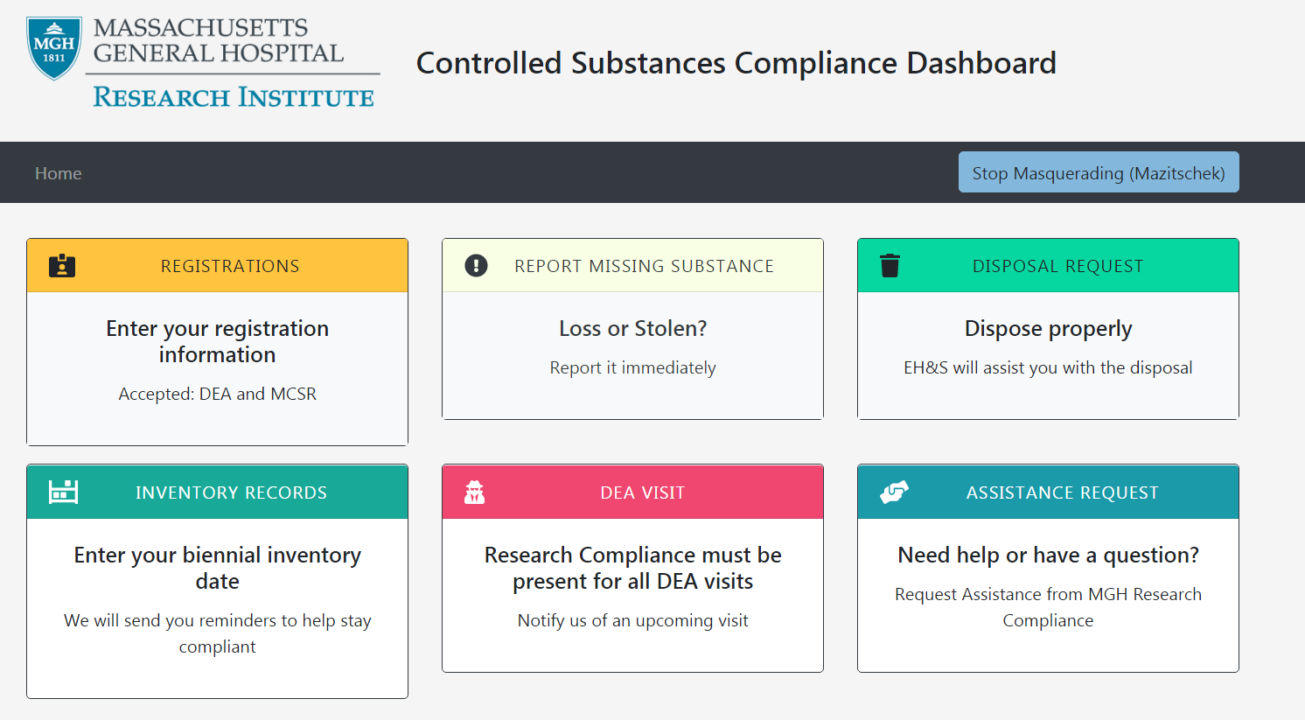
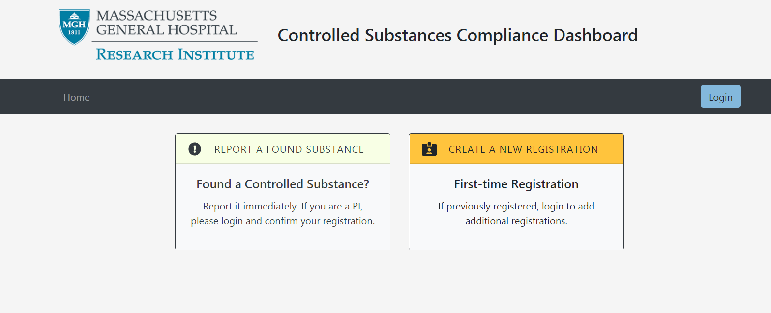
iLog

Slide 8
Labeling and Secondary Containers

Slide 9
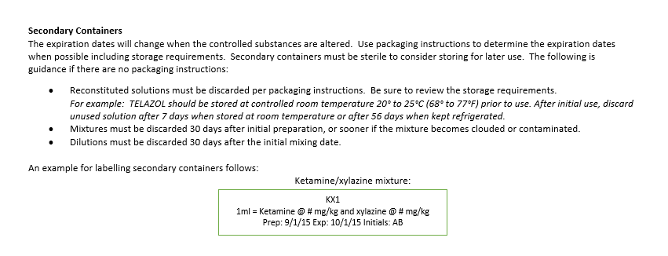
Secondary Containers

Slide 10
Disposal of Controlled Substances

Slide 11
Disposals
Can be scheduled by calling EH&S (# in front of logbook) or by using iLog.
Complete DEA 41 form for day of disposal.
Two signatures in logbook.
Keep copy of DEA 41 form with documentation.
Do not stockpile large amounts of controlled substances.
Mark containers as expired or note not for use.
If you have room, put in different area of CS cabinet.
Be consistent with documentation, use same name of drug on all documents.

Slide 12
Transportation of Controlled Substances

Slide 13
Transportation of Controlled Substances
Controlled substances must not be transported from one location to another as your registration is location specific. The ONLY exception for this requirement is if you need to transport controlled substances to a location in which you are unable to maintain a lockbox or transportation of animals.

Slide 14
Transportation Requirements
Only transport as much controlled substance as is required.
A Controlled Substance Transportation Form must be completed, carried during transport, and stored with the MGH Controlled Substance Accountability Logbook.
Do not exceed the maximum amount defined on the Controlled Substance Transportation Form. If you require additional Controlled Substance or a substance that is not listed, you must have approval from the Director of Research Compliance.
All Controlled Substances are to be transported from the registrant’s Controlled Substance cabinet inventory in an approved locking transport bag*. After use, any residual or remaining controlled substances must be returned to the registered controlled substance cabinet and logged as appropriate.
Empty syringes should be disposed of in an approved sharps container.
Controlled substances must be transported by the registrant or an authorized user.

Slide 15
Transporting Controlled Substances within the Same Building
DEA has given us permission to transport controlled substances within the same building. The following should be observed:
Only transport the amount of drug needed, not entire bottles/containers.
Dispose properly or return to controlled substances cabinet.
Keep substances secure.
Transport form not needed.

Slide 16
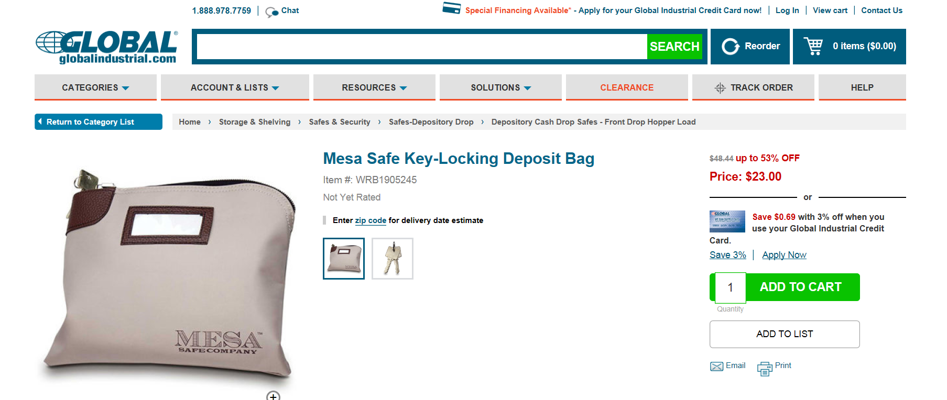

Slide 17
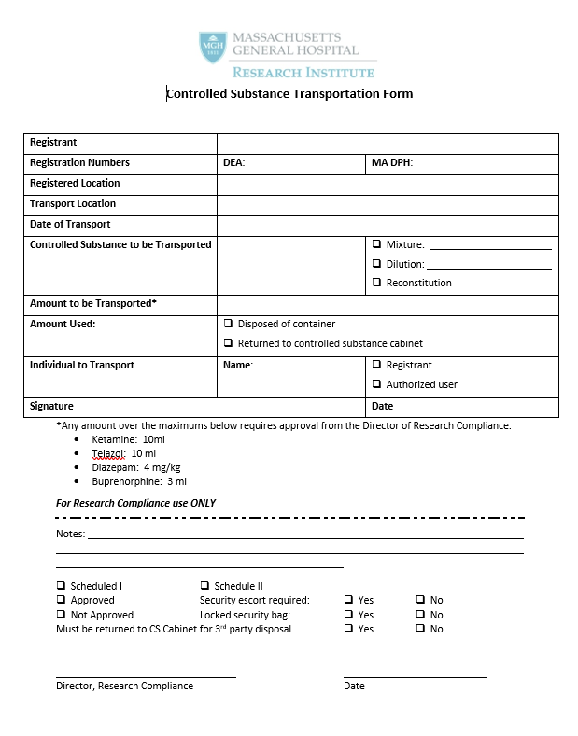

Slide 18
Transferring Controlled Substances
Do not transfer without Research Compliance approval
DEA registration approval does not allow for sale or distribution of controlled substances
In rare circumstances (hard to get CS, lab closure, high dollar), are appropriate times for requests
Must have approved transfer form for records
When controlled substances are transferred from one registrant (registration) to the another, that is transferring controlled substances.

Slide 19
MGH Controlled Substance Accountability Logbook

Slide 20
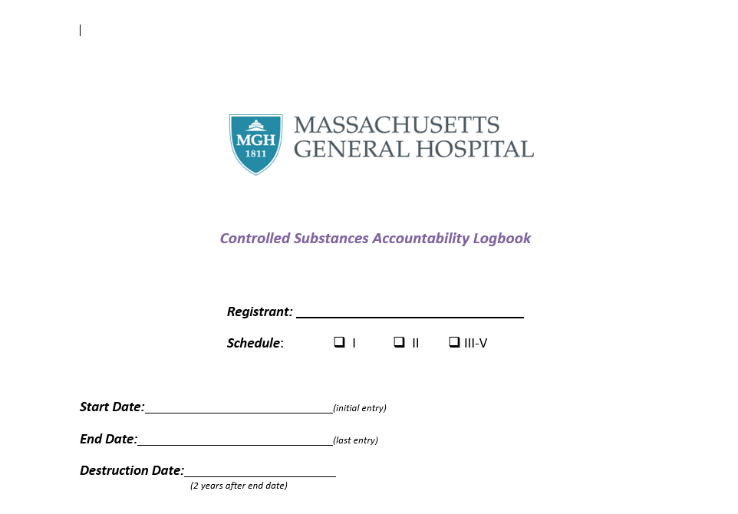

Slide 21
Authorized Users
Must have a reporting, funding, or protocol in common.
Must be listed on the MCSR application or have a submitted amendment.
Must match the Authorized User Log for DEA.
iLog must match MCSR and DEA.

Slide 22
This is a DEA requirement.
Registrant information goes on the top.
Start date is when the DEA registration was first issued.
For site staff, these are the authorized users.
Authorized users must be added to the state MCSR first.
Send amendment return receipt. Use this date as the start date.
Registrant must initial the start and stop dates.

Slide 23
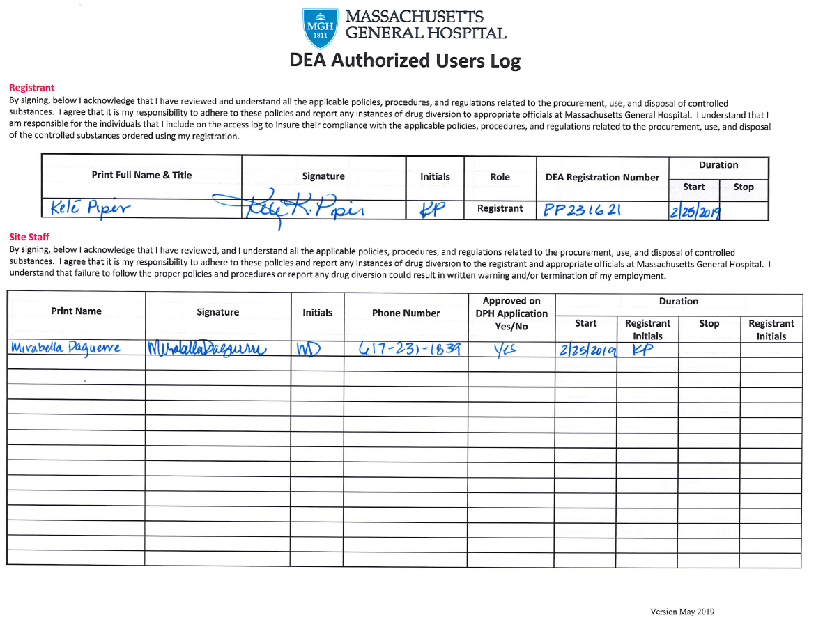
Anything missing?

Slide 24
Missing the title for the registrant.

Slide 25
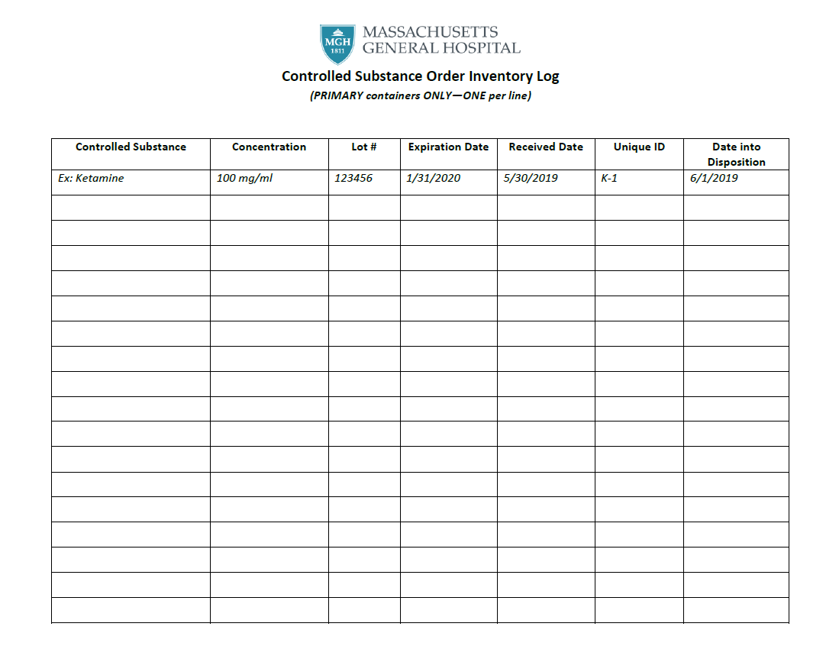
This inventory log is for PRIMARY containers only.
Enter drugs as you receive them in.
Assign each bottle a unique identifier. Write it on the bottle.
The date into disposition is the date you start using the drug.

Slide 26
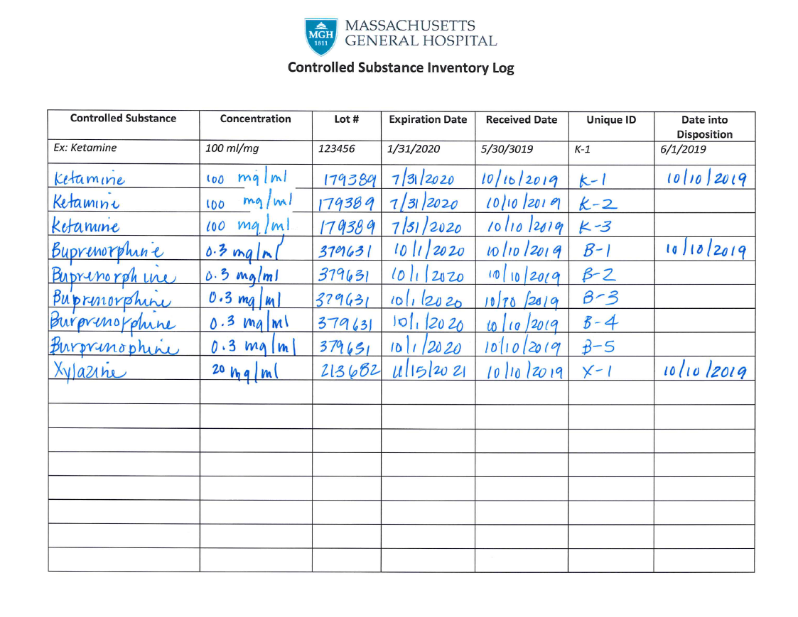
Anything wrong?

Slide 27
Errors need to be corrected by drawing one line through them with initials and date.
Xylazine is a Scheduled VI and not DEA regulated under the Controlled Substance Act.

Slide 28
One bottle per page.
Be sure to enter the starting volume.
Two signatures are required for disposal.
If you have to continue to another page, just note it at the bottom of the page. “Continued on page ..”
No initials, must be a signature.

Slide 29
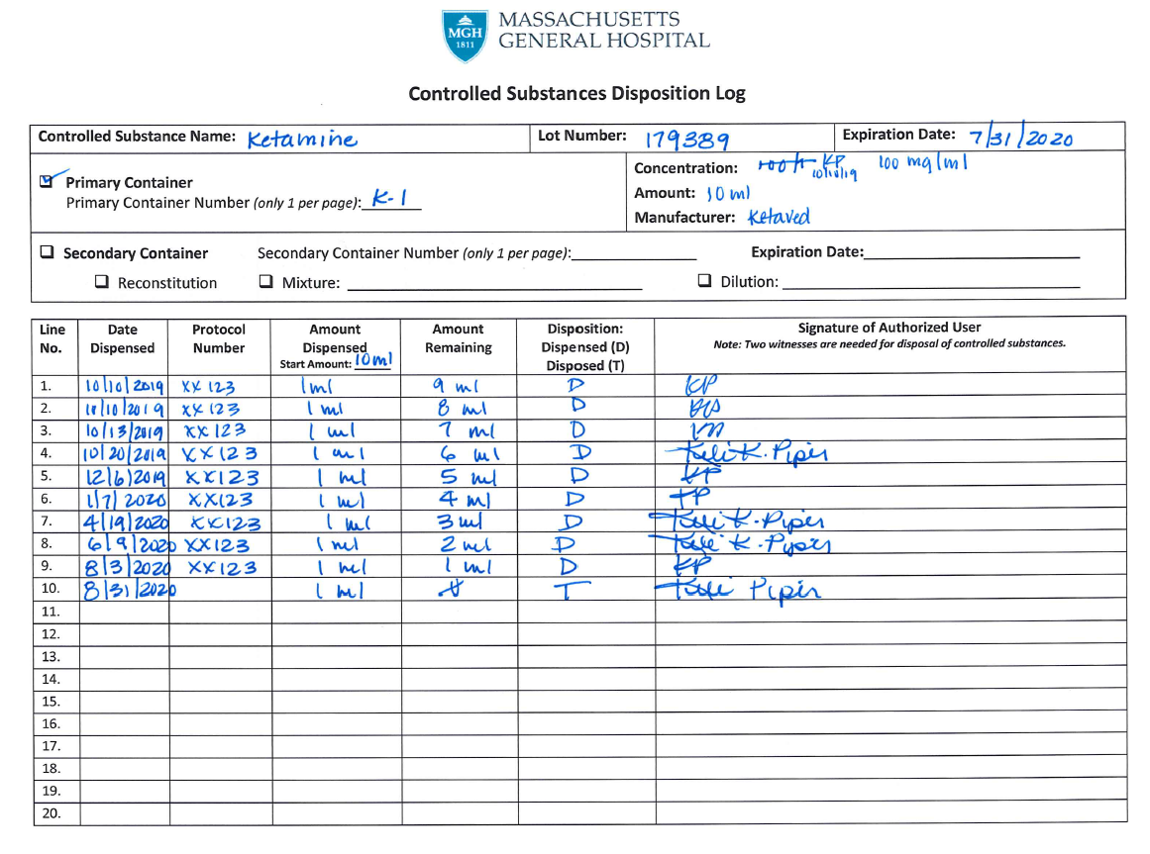
Anything wrong?

Slide 30
You can not use initials on the disposition, must be a signature.
Expired controlled substances cannot be used even in non-survival procedures.
Two signatures are required for disposal of controlled substances. You will also receive a DEA 41 form that needs to be kept with your records.

Slide 31
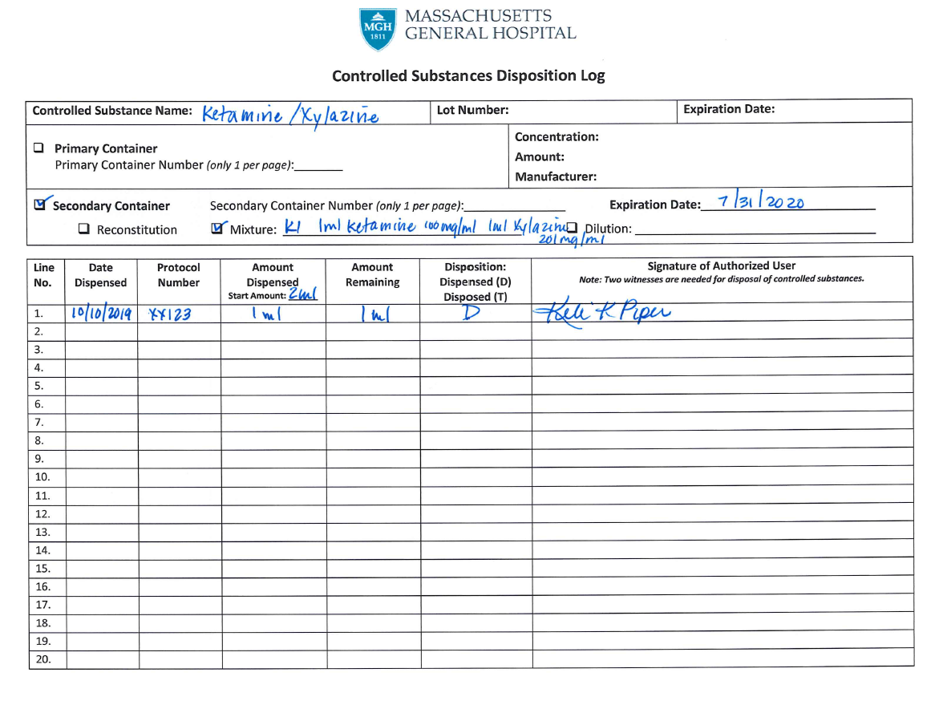
For secondary containers calculate the correct “new” expiration date. Use the guide in the front of the logbook.
List your formulary.
List your starting volume.
Two signatures are required for disposal.
You only have to create a log page if there is going to be leftover stored in the CS cabinet.
Anything wrong?

Slide 32
Missing the unique container identifier, for example KX-1.
The correct expiration date was not calculated, this is from the primary bottle of ketamine. The correct date would have been 30 days from the preparation date, 11/9/2019.

Slide 33
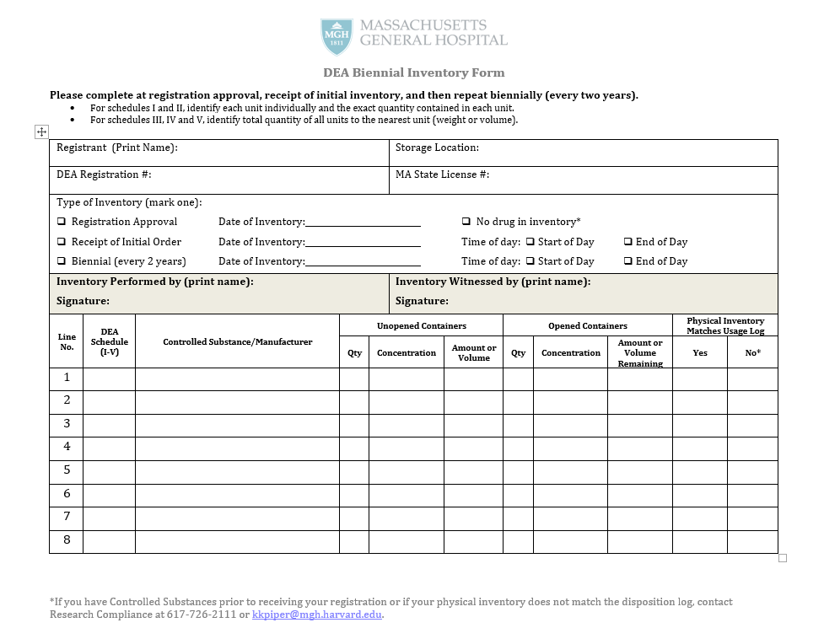
Biennial inventories are a DEA requirement.
There are three points in time when inventories are done.
At registration approval.
Initial order.
Every two years from the initial order.
You only inventory what is in the CS cabinet at the time of the inventory.
Must indicate the time of day.
Must have printed name and signature for both individual performing inventory and the witness.
Only one open container per line.
Include items waiting for disposal.

Slide 34
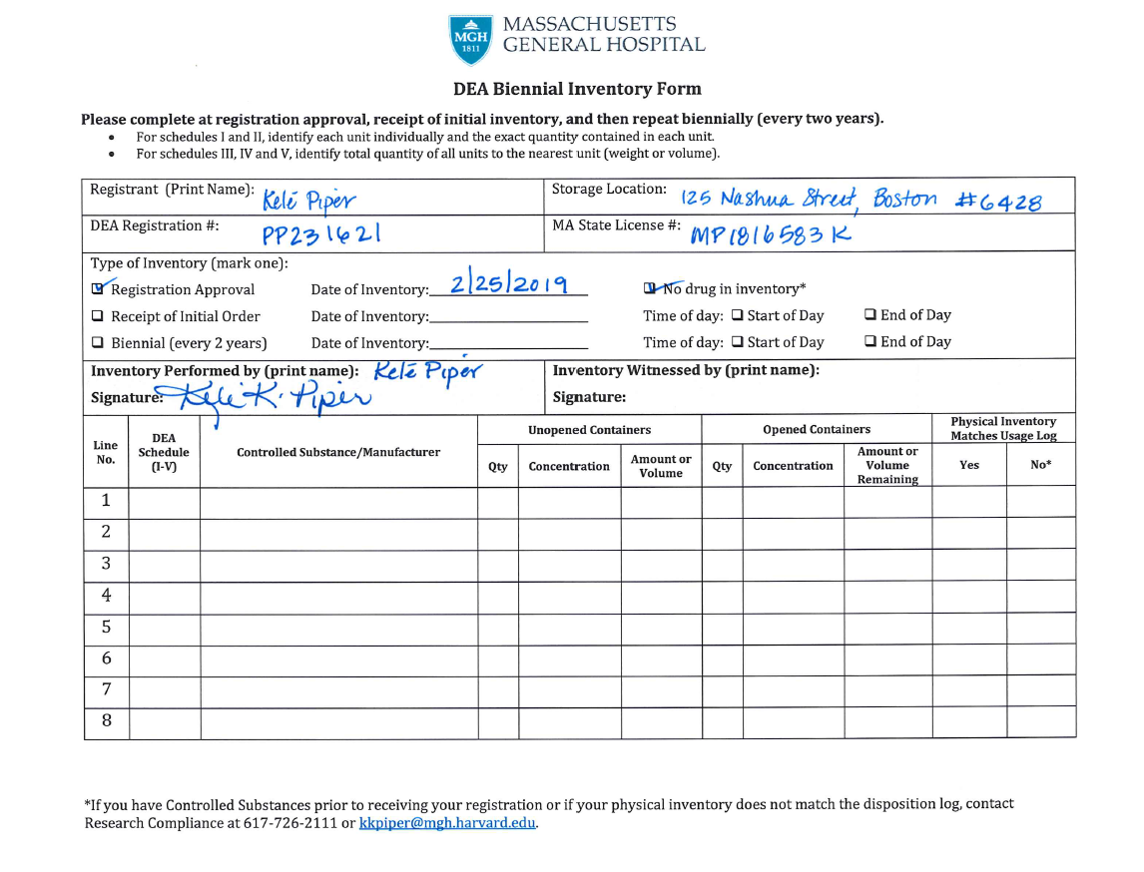
Anything wrong?

Slide 35
Make sure to have printed names and signatures on your biennial inventory.

Slide 36
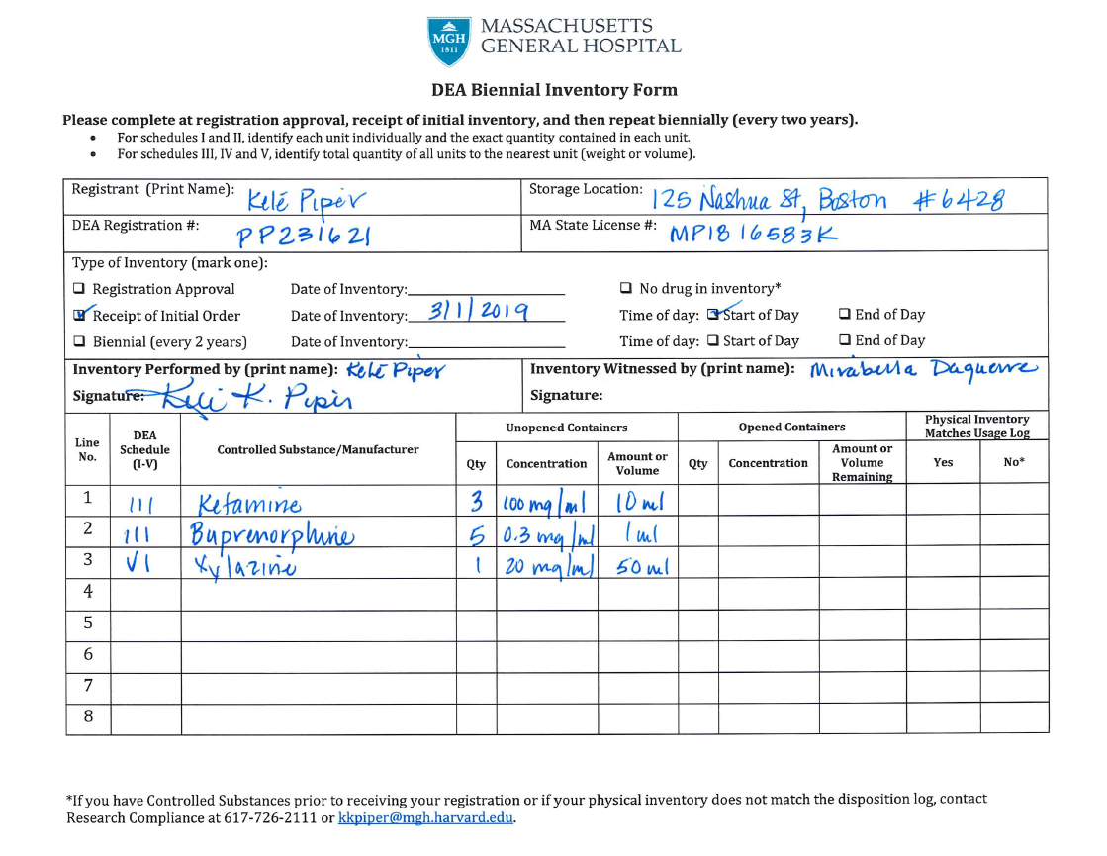
Anything wrong?

Slide 37
Must have signature to be a valid inventory.
Xylazine is a MA DPH Schedule VI drug and should not be included in the DEA biennial inventory nor should it be stored with Schedule I-V DEA regulated controlled substances.

Slide 38
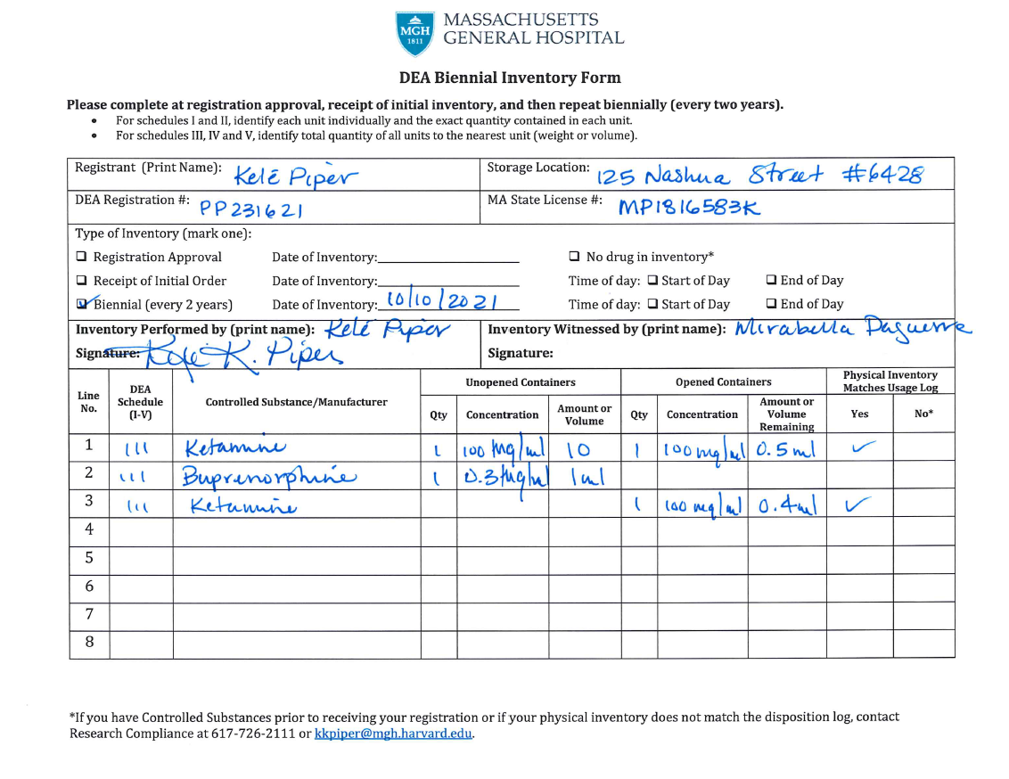
Anything wrong?

Slide 39
This date needs to be two years from the initial order or the last biennial inventory.
DEA requires by regulation that the time of day be recorded on the inventory.
Signatures are required for a valid inventory.
Missing volume measurement.
You must verify the physical inventory to what is in the lockbox.

Slide 40
Common Errors
Cannot share or borrow from another registrant
Improper disposal/infrequent disposals
Expired controlled substances
Shortages/overages
Corrections
Documentation of errors
More than one container per page
No unique identifier
Logging secondary containers
Signatures vs. initials
Schedule VI
Logging Schedules I, II, III-V
Maintaining up-to-date Authorized User Log
Cannot share a safe

Slide 41
Questions?

